Slide 1

Comparative Analysis of Student Grades Across Schools
Group-5:
Geethika Satheesh
Upashana Dutta
Rushika Badri Prasad

Slide 2


Dataset Overview
Total Records: 395 students
Features: 33 variables
Contains: Demographics, Parental Information, Academic Factors, Social and Behavioral Factors and Health and Absences.

Slide 3
Objective
Is the average academic performance (mean G3) of students in MS and GP schools statistically different?
Which statistical test should be used based on the data's adherence to assumptions like normality and equality of variance?

Slide 4
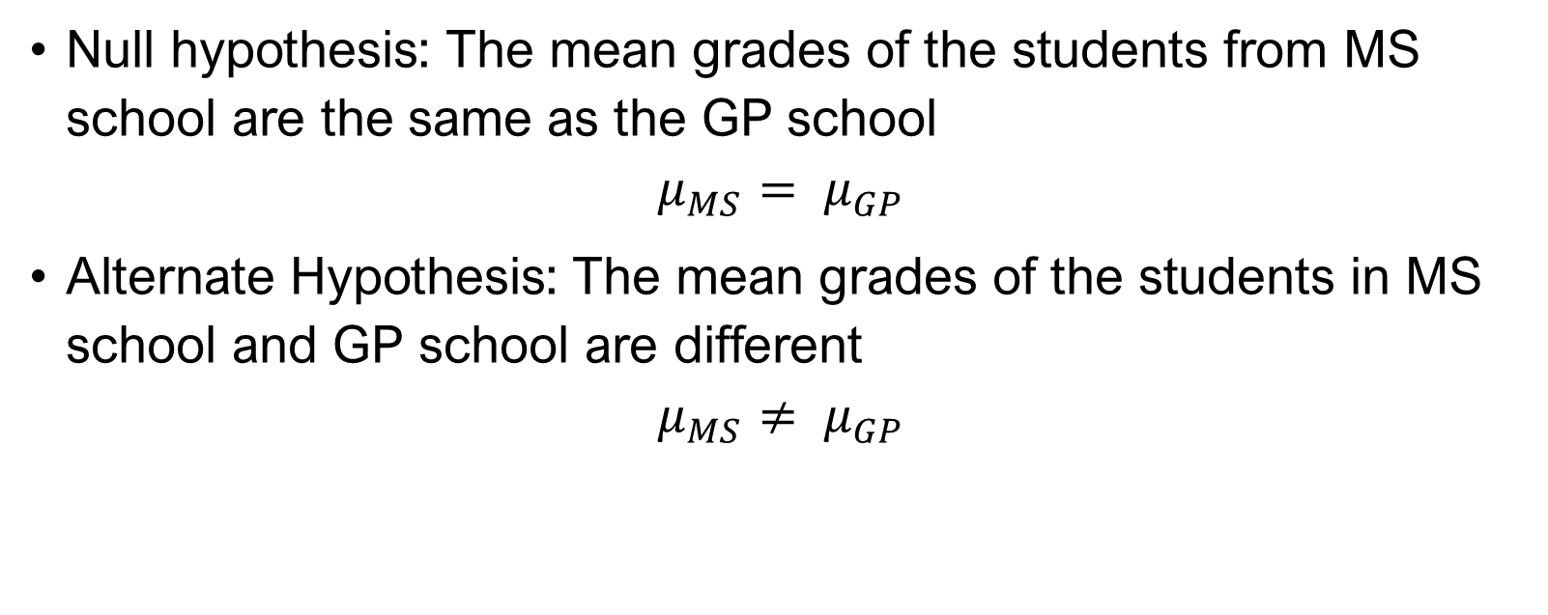
Hypothesis
Null hypothesis: The mean grades of the students from MS school are the same as the GP school
$$μ_{MS}= μ_{GP}$$
Alternate Hypothesis: The mean grades of the students in MS school and GP school are different
$$μ_{MS}{≠ μ}_{GP}$$

Slide 5
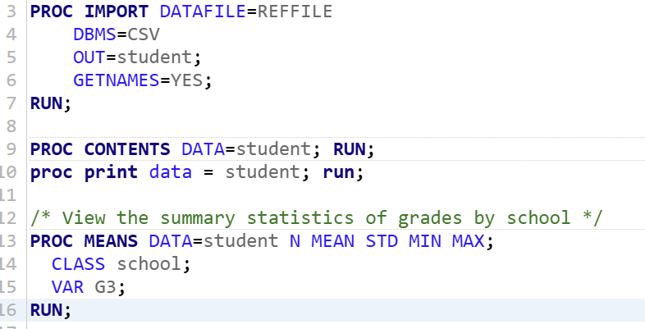
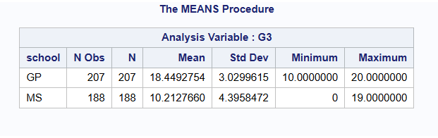
Data Description and Exploration
School GP:
Mean: 18.44
Standard deviation: 3.03
School MS:
Mean of G3: 10.21
Standard deviation: 4.40
School GP demonstrates both higher mean grades and more consistent performance compared to school MS.

Slide 6

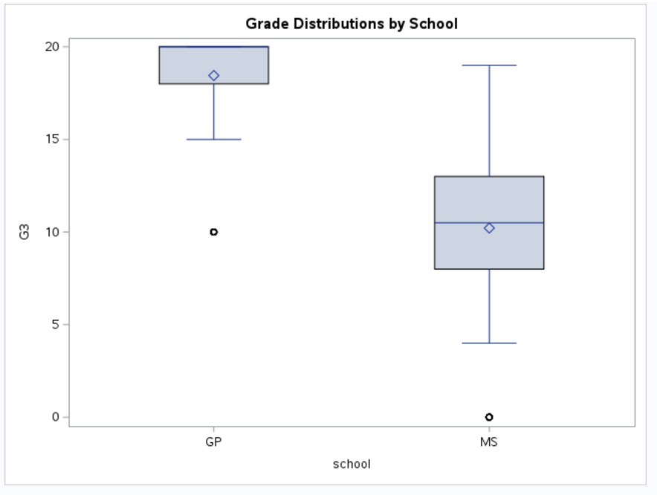
Data Description and Exploration
The visualization highlights significant differences in median grades and variability between GP and MS.
Highlights differences in performance and identifies areas for improvement in grades at school MS.

Slide 7
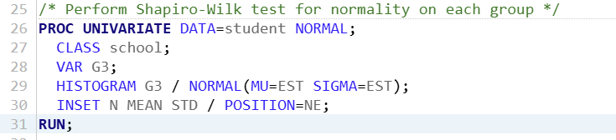
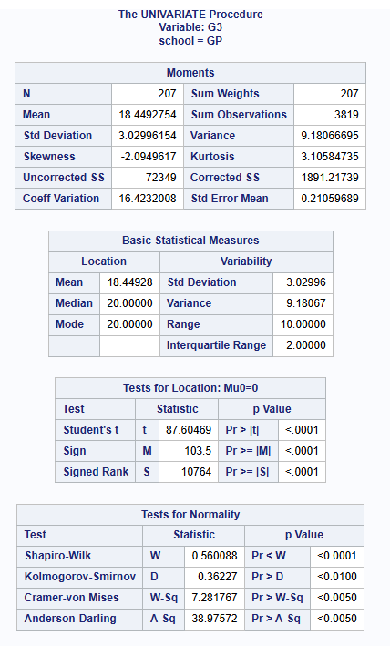
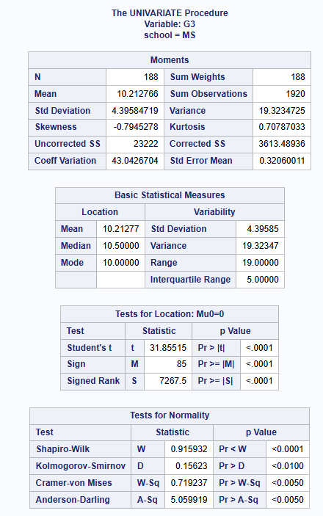
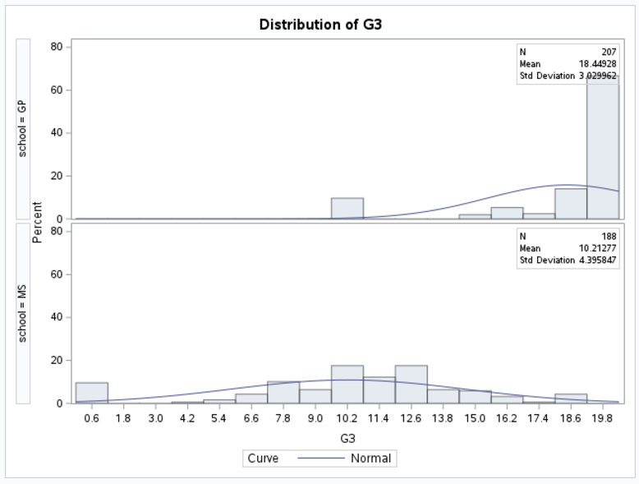
Test for Normality
Mean Grades: Students in School GP have a higher average grade (18.45) compared to School MS (10.21).
Grade Variability: Grades in School GP are less variable (Standard Deviation: 3.29), whereas School MS shows more variability (Standard Deviation: 4.39).
Non-Normal Distribution: Both schools' grades significantly deviate from normality, as all normality test p-values are < 0.0001.
Distribution Insights: GP's grades are highly skewed toward the maximum value (20), while MS exhibits a more balanced spread of grades.

Slide 8
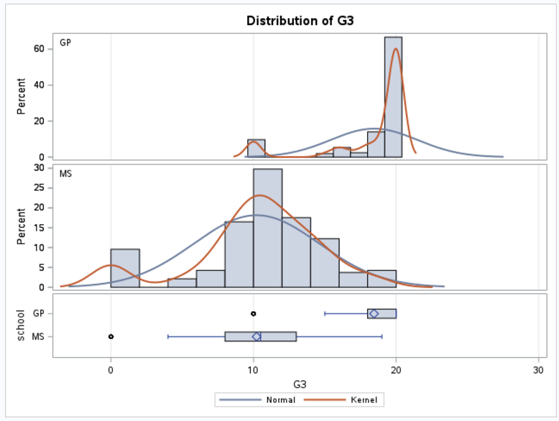
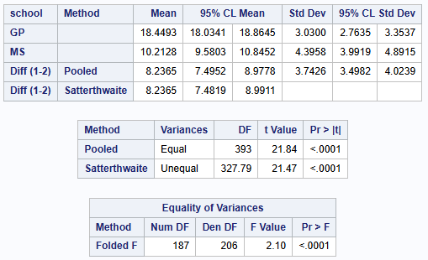
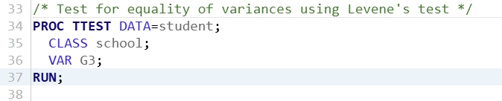
Test for Equality of Variance
The Folded F Test showed significant variance differences between GP and MS (p < 0.0001).
T-test results confirmed GP students had significantly higher mean G3 scores than MS.
Graphs highlighted GP's concentrated scores and MS's greater variability.
Overall, disparities were observed in performance and score variability between schools.

Slide 9
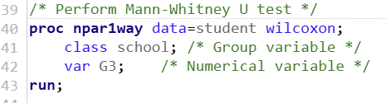
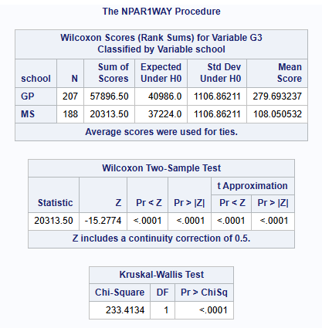
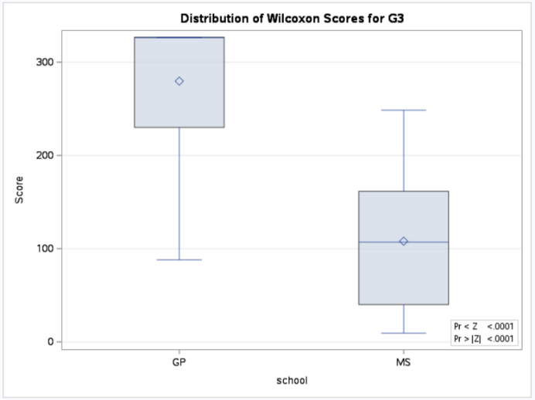
Mann – Whitney U Test
Mann-Whitney U Test: Used to compare G3 scores between GP and MS due to violated normality assumptions.
Significant Differences: P-value < 0.0001 confirms a statistically significant difference in grade distributions.
Rank Sums and Boxplot: Highlight GP's higher median rank scores compared to MS.

Slide 10

CONCLUSION
Since the normality assumption is violated, the Mann-Whitney U test is a suitable non-parametric alternative for comparing G3 distributions between the two schools. The test results reveal a statistically significant difference in grades, confirming that the distributions of student grades in GP and MS differ significantly. This suggests that students' performance varies across the two schools.

Slide 11
References
https://www.sciencedirect.com/science/article/pii/S088303552300112X
https://pmc.ncbi.nlm.nih.gov/articles/PMC1120984/
https://link.springer.com/article/10.1007/s12564-019-09614-z?fromPaywallRec=true

Slide 12

Thank You!

